Slide 1
Industrial Management

Slide 2
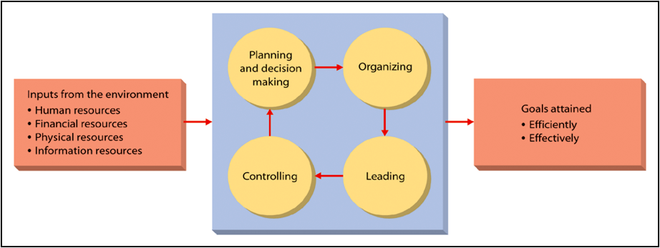
Define Management

Slide 3
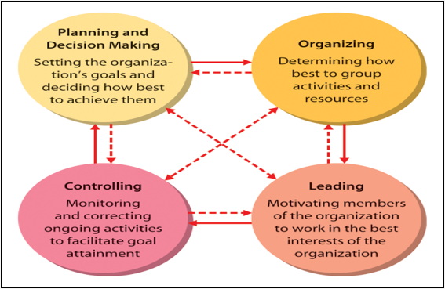
Key Aspects/Functions/Process of Management

